Slide 1
CDS Insights Onboarding SP 21
Supervised Machine Learning Models
CDS Education (Jerry, Raye, and Sam)
Some Slides Adapted from Info 1998, CS 4780, Mehta, Yang, and Takatsu
Notes:
Slides, materials provided, no need to take notes

Slide 2
The Data Pipeline
Problem Statement
Summary and visualization
Statistical and predictive results
Raw data
Usable data
Meaningful output
Data cleaning, imputation, normalization
Data analysis, predictive modeling, etc.
Solution
Debugging, improving models and analysis
We are here!
https://towardsdatascience.com/5-steps-of-a-data-science-project-lifecycle-26c50372b492
Notes:
Good link for getting a rough idea of the data science project cycle; includes links for further review including

Slide 3
Different Types of ML
(Supervised & Unsupervised) (Classification & Regression)

Slide 4
What is Supervised Machine Learning?
When ground-truth labels are known, so when we are training we check if we predict the training examples correctly
Prediction is compared with known label to improve the algorithm.
Classification = if the variable we are predicting is discrete
example: genre of music
Regression = if the variable we are predicting is continuous
example: box office returns for a movie

Slide 5
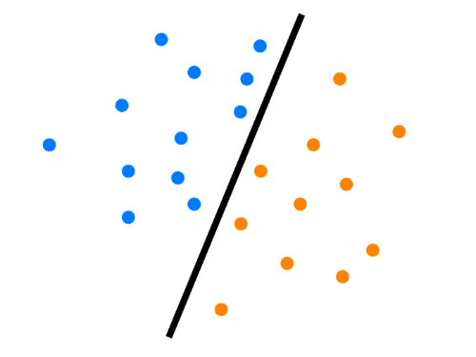

2 Types of Supervised ML Problems
1
Regression
2
Classification

Slide 6
Regression
1
Continuous Dependent Variable
Predict the box office revenue for a movie
Predict revenue for a new gas station
Predict the price of a certain stock / house

Slide 7
Classification
2
Dependent Variable is Categorical / Discrete
Binary: Predict if a passenger on the Titanic survived or perished
Binary: Predict if an email is spam or not spam (ham)
Multi-Class: Predict the type of cuisine based on ingredients in a recipe

Slide 8
Linear Regression

Slide 9
Linear Regression
y = B₀ + B₁x₁ + … + B_{p}x_{p}
x is an input; x₁, x₂ , …, x_{p} are the features of x
y is an output (usually a single value)
B’s are “weights”
A linear regression equation is defined by its B’s
Given a set of x’s and y’s, the program finds a set of B’s that (almost) satisfies the equation above for all x’s and y’s
Then, you can plug in the feature values of a new x and to predict its y
Notes:
Example: Weather - humidity, wind, temperature, cloudy, last time since rained -> inches of rainfall

Slide 10
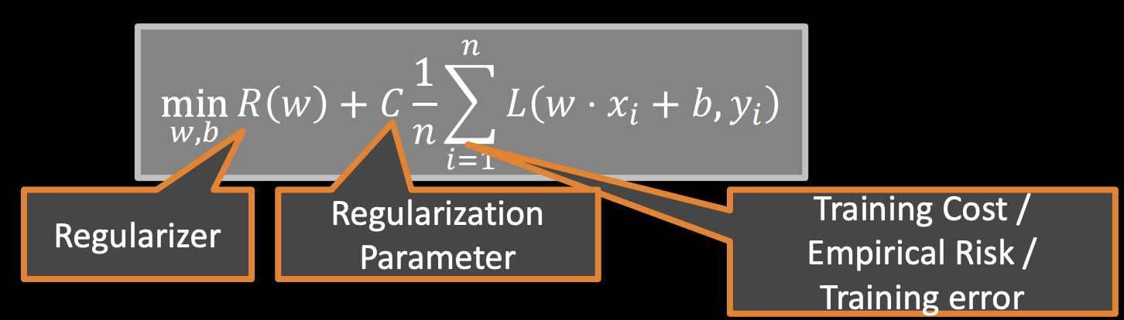
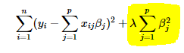
General Form for Many ML Algorithms
Least Squares objective: 𝛽 = argmin
Notes:
Not always in this form but most will have these components
Loss: L2, squared error, minimizing it to become least squared error

Slide 11
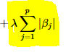
Common Linear Regression Variations
Simple Least Squares - L2 loss, no regularization
Prone to overfitting
Ridge Regression - L2 loss, L2 regularization
Small (not zero) but well distributed
LASSO - L2 loss, L1 regularization
Sparse weights (can reach 0)
Elasticnet - LASSO+Ridge
Notes:
Elasticnet has another variable that controls how much of Ridge and how much of LASSO

Slide 12
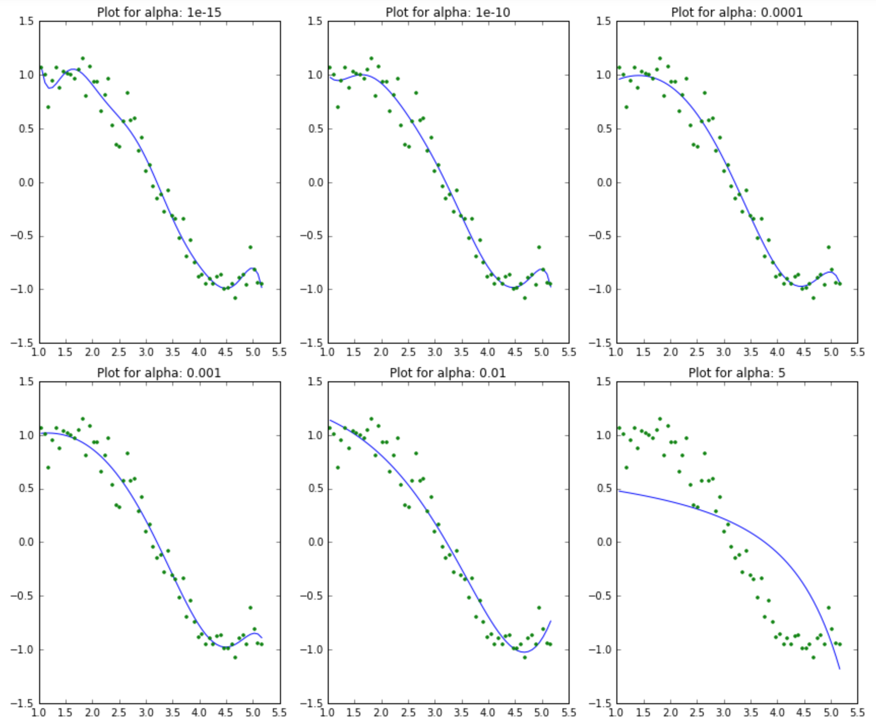
Common Linear Regression Variations

Slide 13
Demo

Slide 14
Loss Functions (Quantifying Error)
Compare predicted result with known label and outputs some value
We want to minimize the loss by changing the inputs that we can control (the weights)
If our training set is good and we didn’t overfit, then minimizing the loss should also minimize our error on new data
Notes:
Loss helps us determine what we value, the kind of loss function we use will determine how we value certain data points

Slide 15
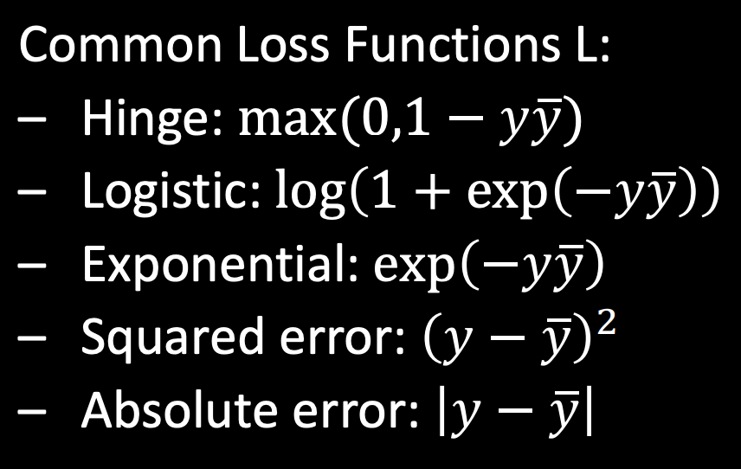
Examples of Loss Functions
Notes:
Y bar is not average, should just be predicted value y hat
L2 and L1 are squared and absolute, think of 2 and 1 as the powers
Hinge mostly works on binary classification which we haven’t covered yet but essentially prioritizes getting the correct class and doesn’t care as much as to how correct or incorrect something is
Logistic is similar to how a logistic function looks, prioritizes loss of values that are close to the correct one but if it’s far off then the loss value only marginally increases, robust to outliers,

Slide 16
Choosing Loss Functions
Depends on type of a data
Real
Boolean
Ordinal (categorical)
Nominal
And on noise
Small? Large but sparse?
From some probabilistic model?

Slide 17
Loss functions for real-valued data
Quadratic/L2
L1
Huber
Quantile
...

Slide 18
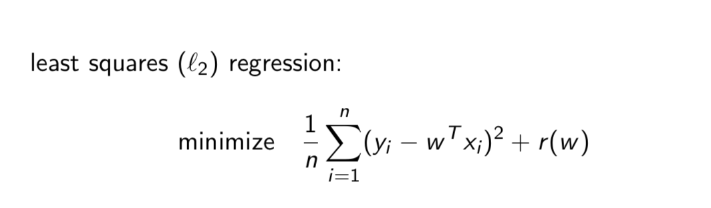
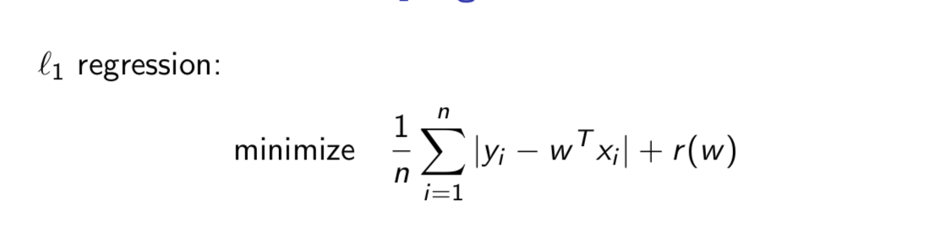
Least Square Regression (l2) & l1 Regression

Slide 19
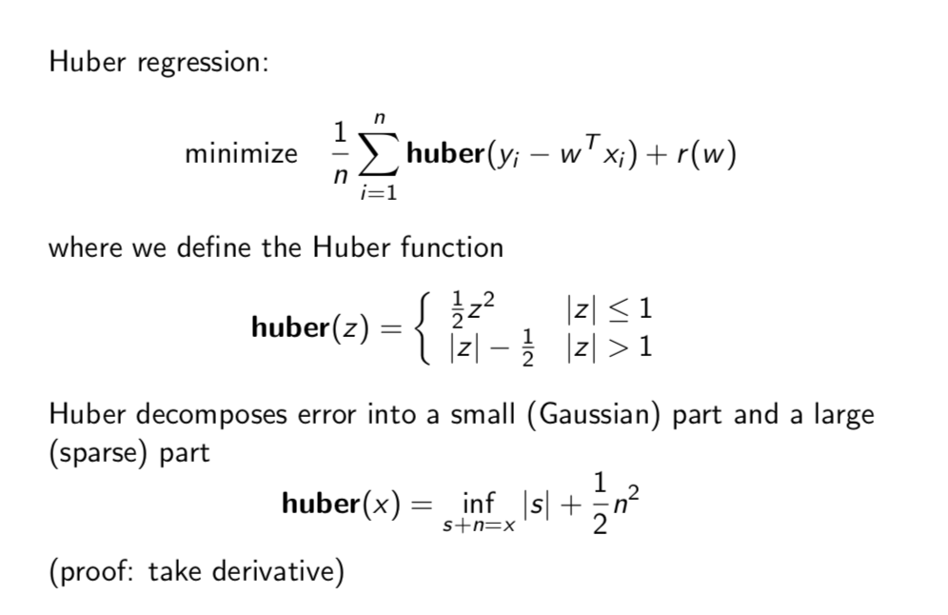
Huber Regression

Slide 20
Robust Statistics
L1 and Huber loss functions are called robust loss functions
When to use them?
For robustness in the presence of large outliers
Large, infrequent sensor malfunctions
People lying on surveys
Anything that’s not a sum of small iid random variables

Slide 21
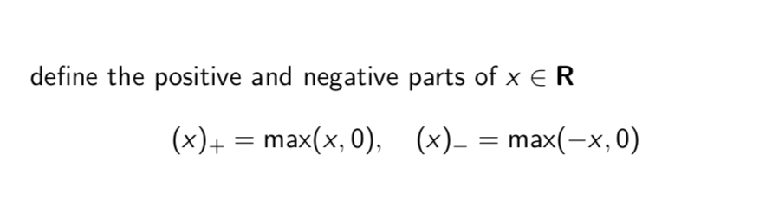
Notation

Slide 22
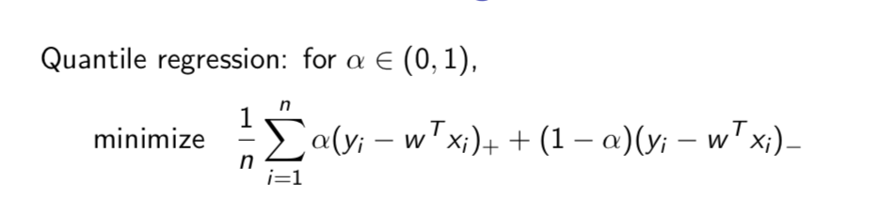
Quantile Regression

Slide 23
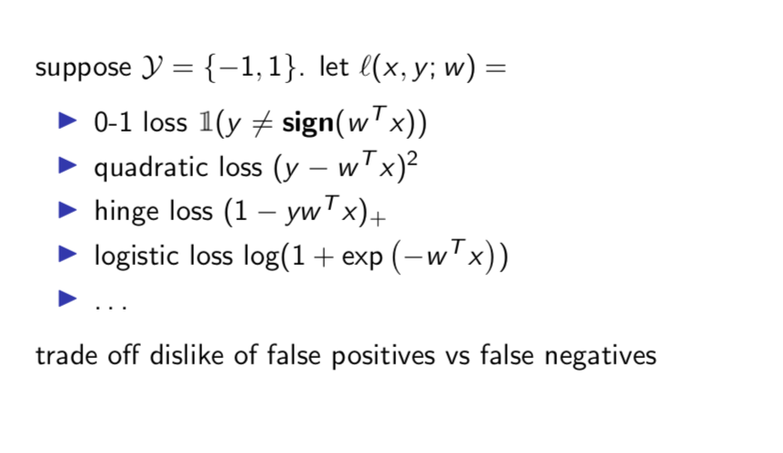
Loss functions for classification
Will cover more next time when talking about classification

Slide 24
Minimizing Loss
Gradient Descent
Recall: the gradient points in the direction the function is most rapidly increasing (and opposite to the direction the function is most rapidly decreasing)
At each iteration shift the weights in the opposite direction of the gradient of the loss function, until it converges to some local minimum.

Slide 25

Gradient Descent Visual
J is the loss function, theta_0 and theta_1 are the weights
Initial value may affect result

Slide 26
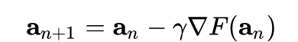
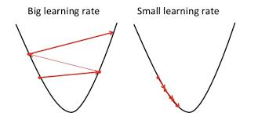
Gradient Descent Quick Maths
γ is an arbitrary learning rate for how far to move down the gradient. Lower value = more iterations to converge, higher value risks overshooting and diverging.

Slide 27
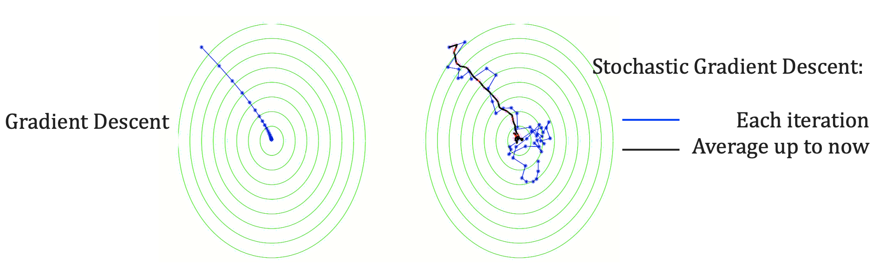
Gradient Descent Cont’d

Slide 28
Gradient Descent Cont’d

Slide 29
Comparing Models

Slide 30
Train-Test Split
Split the data into training set and test set:
Eg: 75%-25%
In train set: use (xi, yi) to fit a model
In test set: use xi to predict yi_hat then compare it to true yi

Slide 31
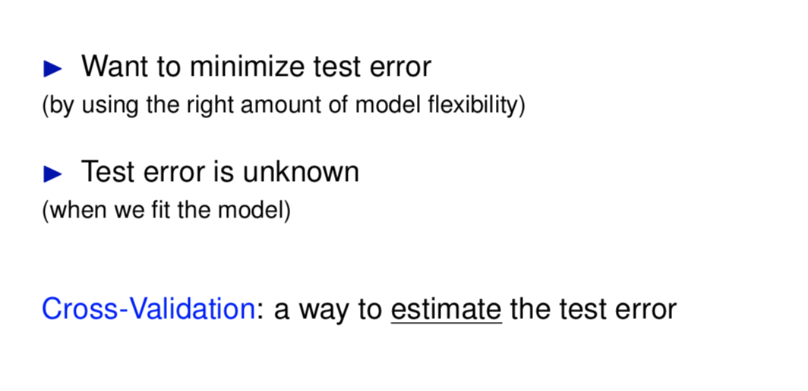
Cross Validation

Slide 32
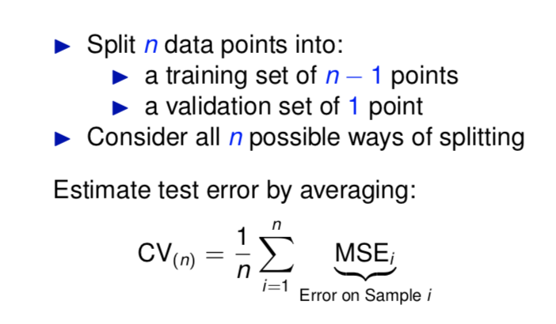
LOOCV (Leave-One-Out)

Slide 33
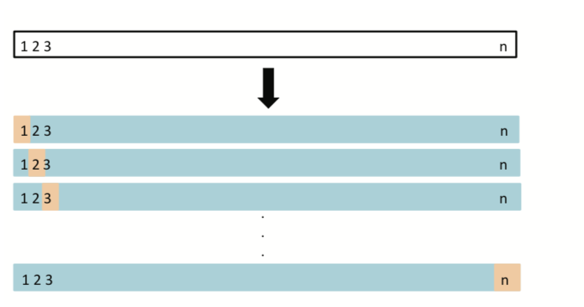
LOOCV (Leave-One-Out)
Complexity is HUGE!

Slide 34
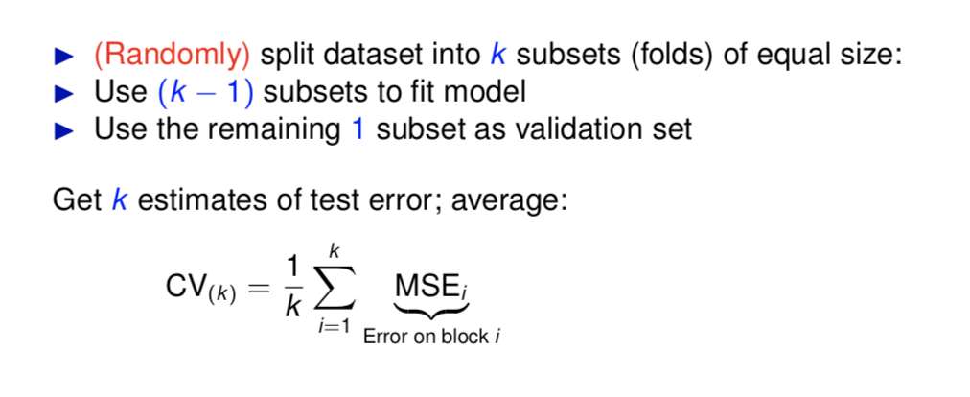
k-Fold Cross-Validation

Slide 35
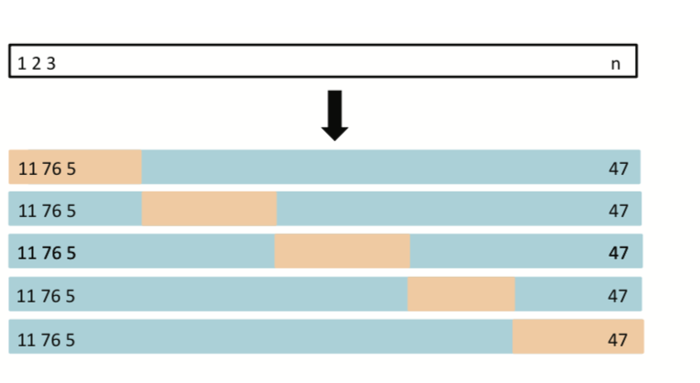
k-Fold Cross-Validation
LOOCV: equivalent to k = n. Typically k-fold has k = 5 or k = 10, and runs faster than LOOCV.

Slide 36
Other Methods
AIC / BIC
Confusion Matrix (for classification problem)
R^2
F-test
...

Slide 37
AIC (Akaike Information Criterion)
an estimator of out-of-sample prediction error
most frequently used when one is not able to easily test the model’s performance on a test set in standard machine learning practice (small data, or time series).
particularly valuable for time series, because time series analysis’ most valuable data is often the most recent, which is stuck in the validation and test sets.
AIC = -2log-likelihood + 2(# of parameters in the model)

Slide 38
AIC for time series
AIC = ln(sigma^2) + (n + 2k)/n
sigma^2 = SSE/n, where SSE is the sum of squared error and n is the sample size, thus sigma^2 is the MLE of the variance of the noise
K = # of parameters in the model
Thus AIC penalizes both the complexity of the model and the accuracy of fitting.

Slide 39
Bias corrected AIC
AIC = ln(sigma^2) + (n + k)/(n - k - 2)
sigma^2 = SSE/n, where SSE is the sum of squared error and n is the sample size, thus sigma^2 is the MLE of the variance of the noise
K = # of parameters in the model
Thus AIC penalizes both the complexity of the model and the accuracy of fitting.

Slide 40
BIC (Bayesian Information Criteria)
BIC = ln(sigma^2) + kln(n)/n
The penalty for model complexity is larger for BIC than AIC, thus BIC tends to prefer smaller and simpler models
Report all 3 criterions to see if they agree with each other.

Slide 41
R^2
R^2 = (SSE_0 - SSE)/SSE_0
Where SSE_0 = sum^n_{t = 1} (x_t - mean(x))^2
represents the proportion of the variance for a dependent variable that's explained by an independent variable or variables in a regression model.
Ranging from 0 to 1.

Slide 42
R^2
R^2 = (SSE_0 - SSE)/SSE_0
Where SSE_0 = sum^n_{t = 1} (x_t - mean(x))^2
represents the proportion of the variance for a dependent variable that's explained by an independent variable or variables in a regression model.
Ranging from 0 to 1.

Slide 43
Overfitting vs. Underfitting
Overfitting: Model is too complex, train-set error low, test-set error high
Underfitting: Model is too simple, train-set error high, test-set error high
Generalization: a good balance between train and test set error, indicating a relatively preferable model

Slide 44
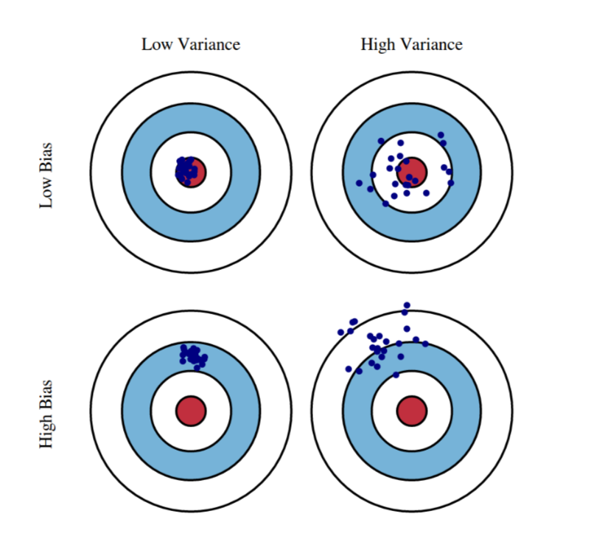
Bias-Variance Trade-off

Slide 45
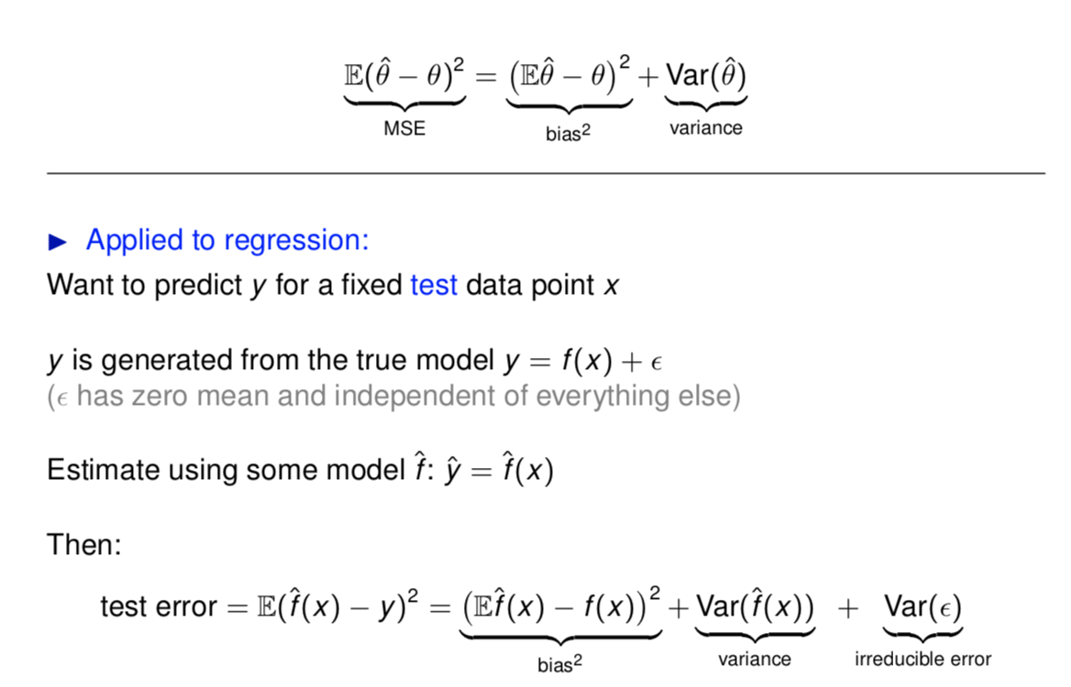
Bias-Variance Trade-off

Slide 46
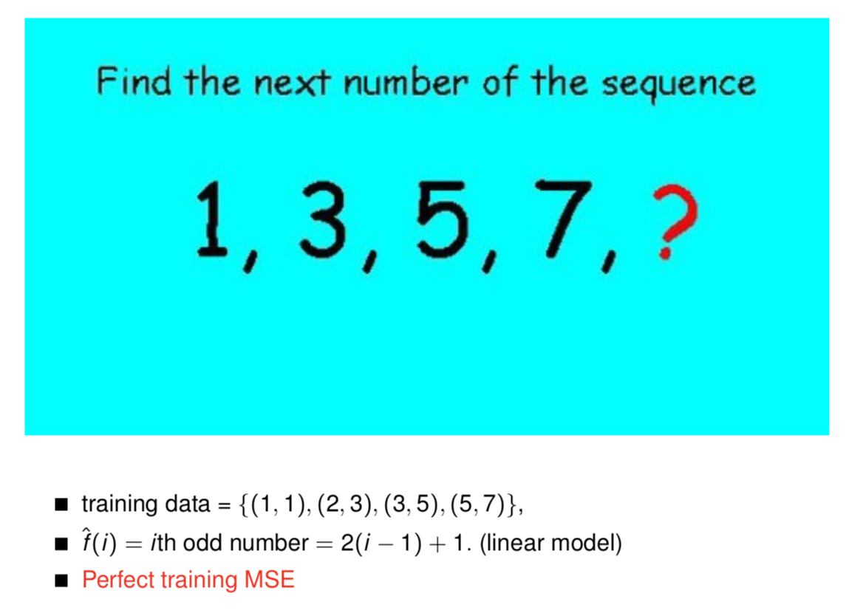

Slide 47
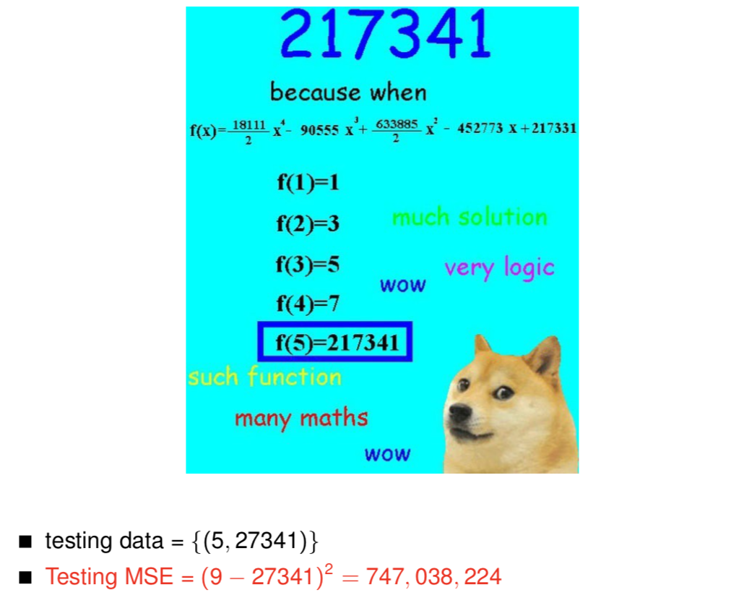

Slide 48
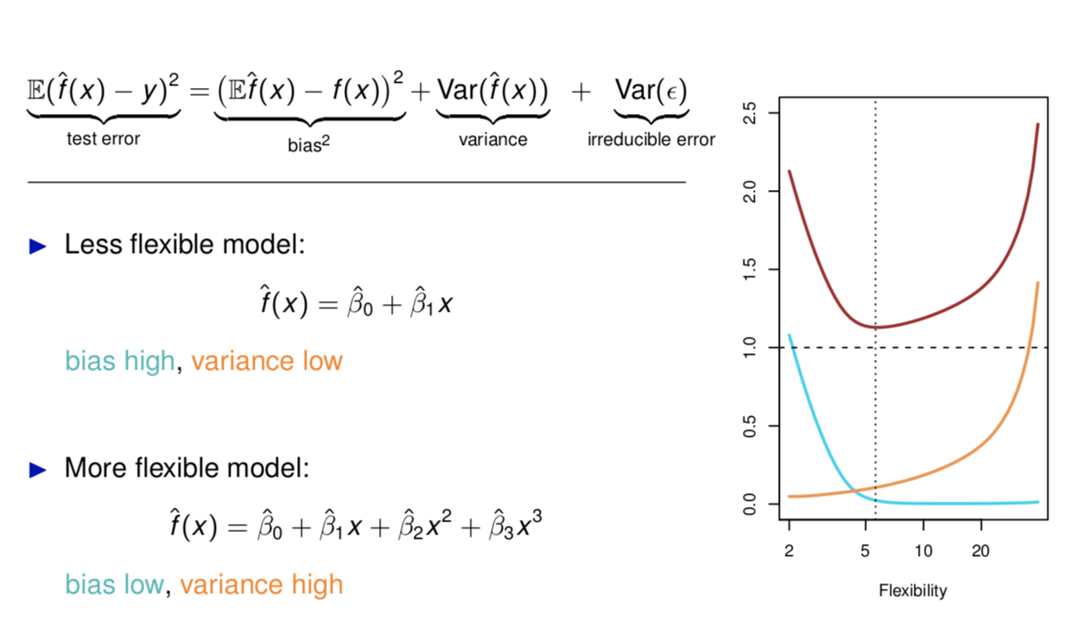

Slide 49
Regression
AND
Classification

Slide 50
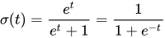
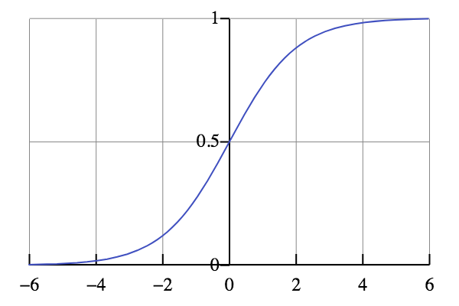
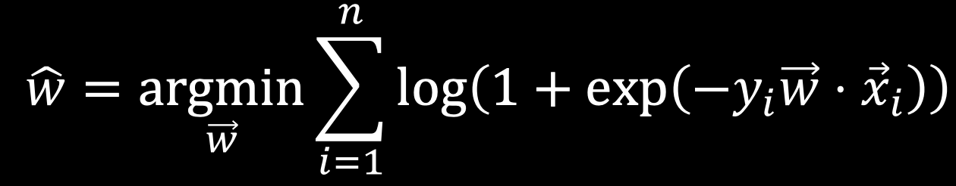
Logistic Regression
Logistic Regression uses this rule instead:
y = 1 if σ(W · x) > Ɛ else 0
Where and Ɛ is some arbitrary threshold (i.e. 0.5)
Choice of weights and threshold determines model performance
How likely will [event] happen? or
Is this [entity] [A] or [B]

Slide 51
Demo

Slide 52
Non-linear Methods

Slide 53
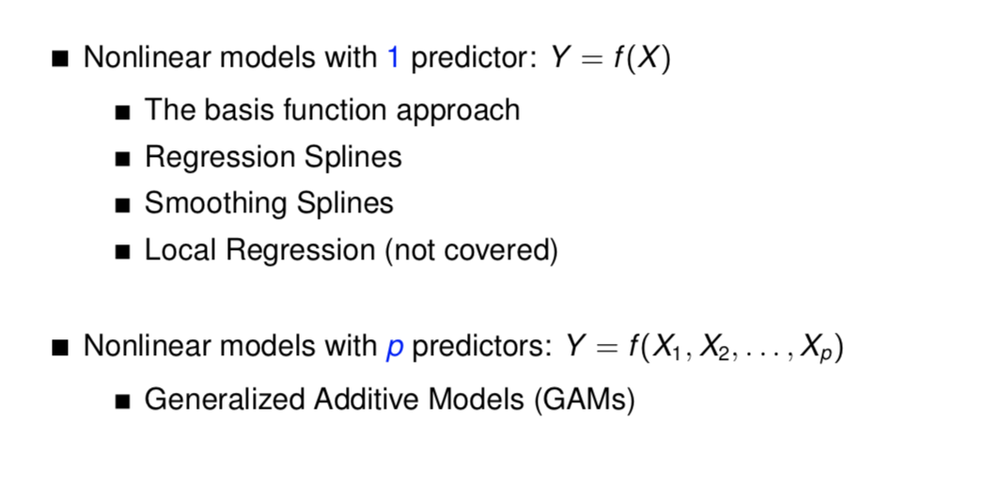
Non-linear Methods

Slide 54
Polynomial Regression
Adding higher order terms to basic functions.
Transformation: log, exponential, cubic, etc.

Slide 55
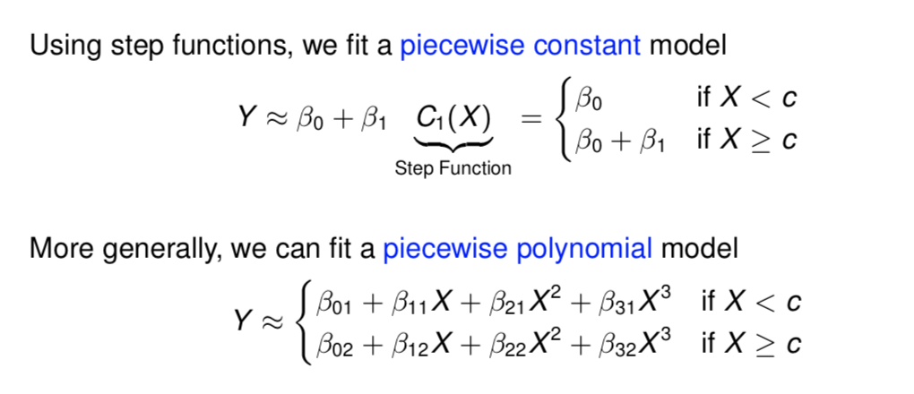
Regression Spline

Slide 56
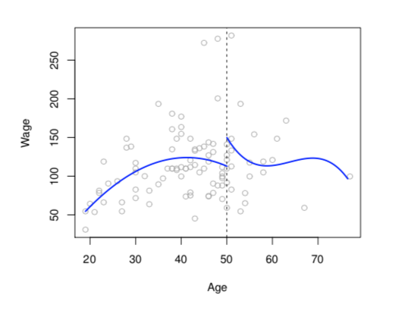

Slide 57
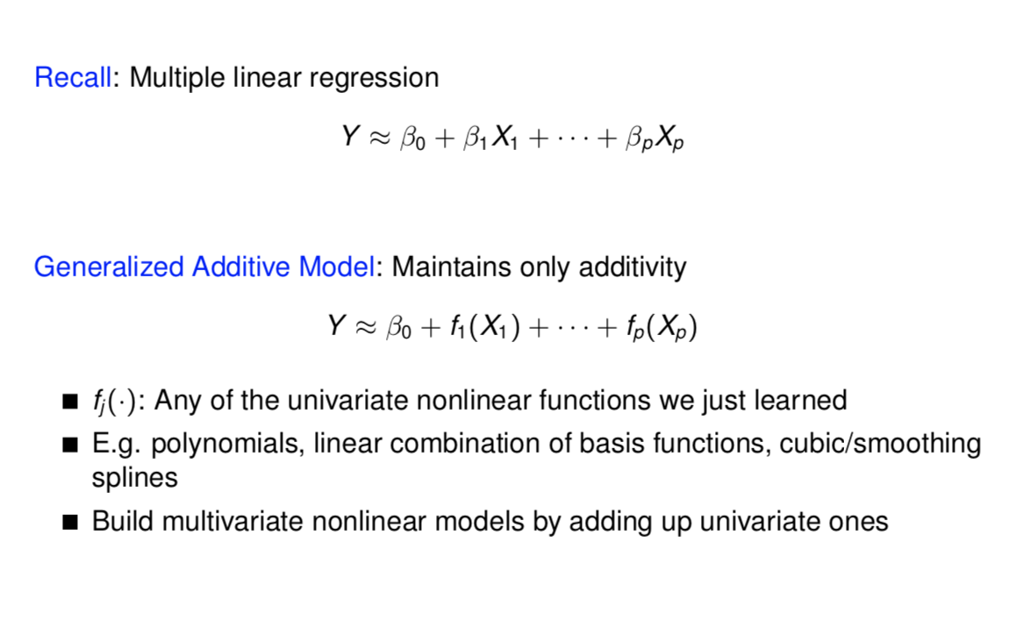
GAM (Generalized Additive Models)

Slide 58
Interpretable ML
Rich Caruana, IBM
Interpretable machine learning tools, glass-box
Evolved from GAM
Explainable Boosting Machine
Easy for developers to find bias, then edit the model
Usually the accuracy of training and the intelligibility of models have a negative correlation (intelligibility goes down as the model gets more complicated). However, EBM has both very high

Slide 59
Classification

Slide 60
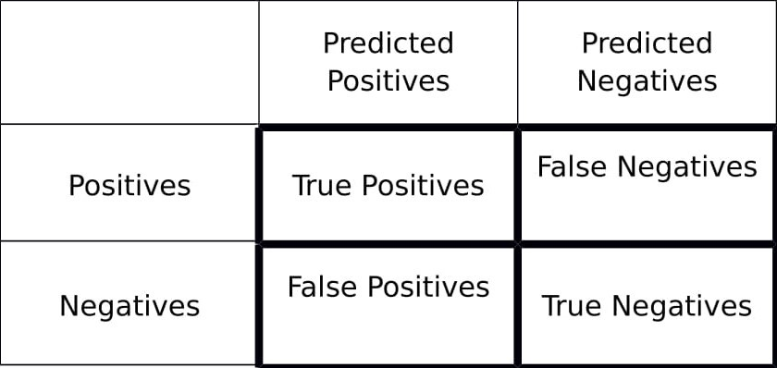
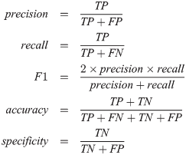
Confusion Matrix and Accuracy Measures

Slide 61
Methods

Slide 62
Tree Models

Slide 63
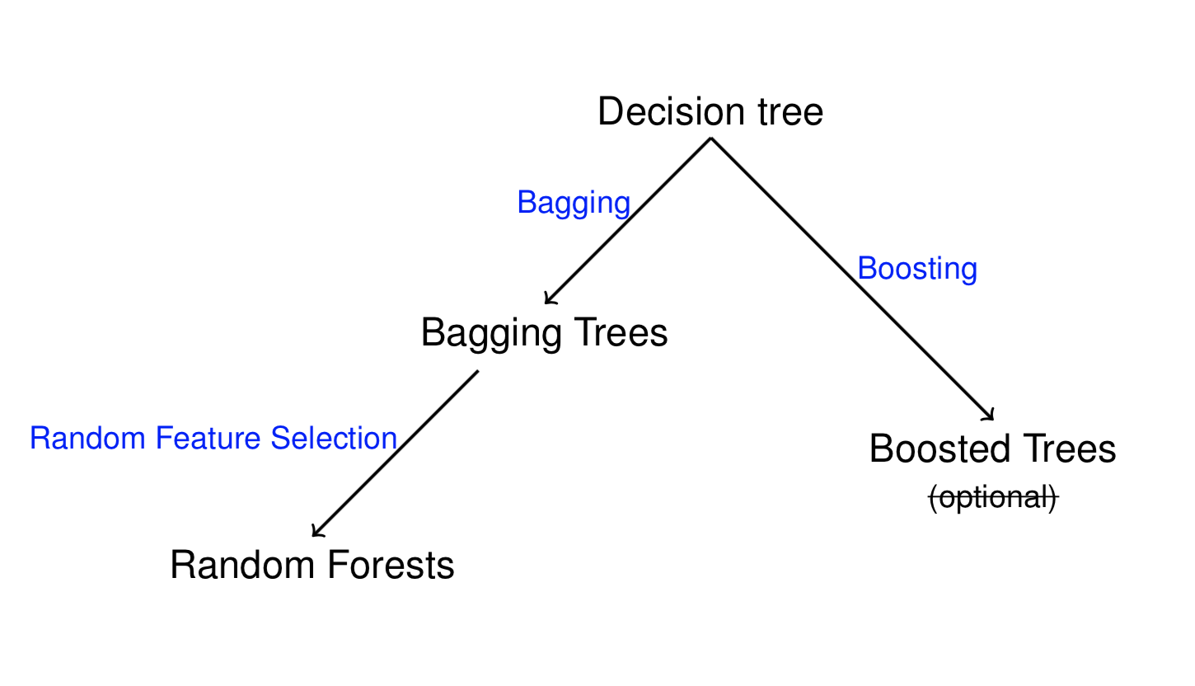
Tree Models
Popular for classification, but works for regression as well

Slide 64
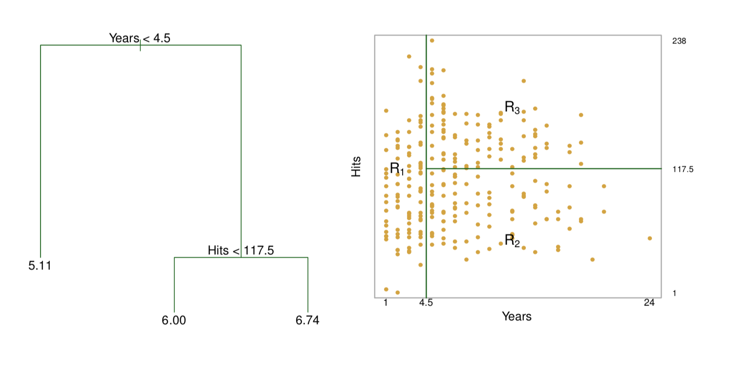
Decision Tree for Regression
Leaf, internal nodes, branch, split

Slide 65
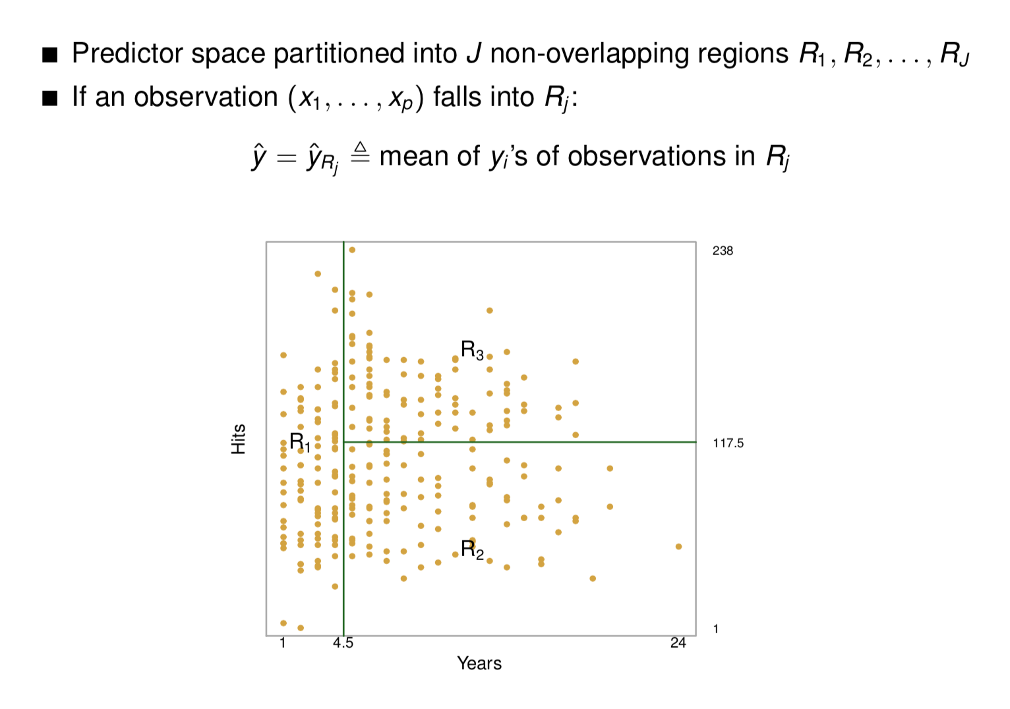
Prediction

Slide 66
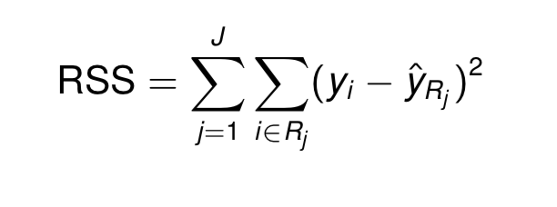
Prediction
There are J number of regions Rj. Ideally, we want to minimize the residual sum of squares:
However a more doable way is to fit a tree greedily:
First fit a large tree
Then prune it

Slide 67
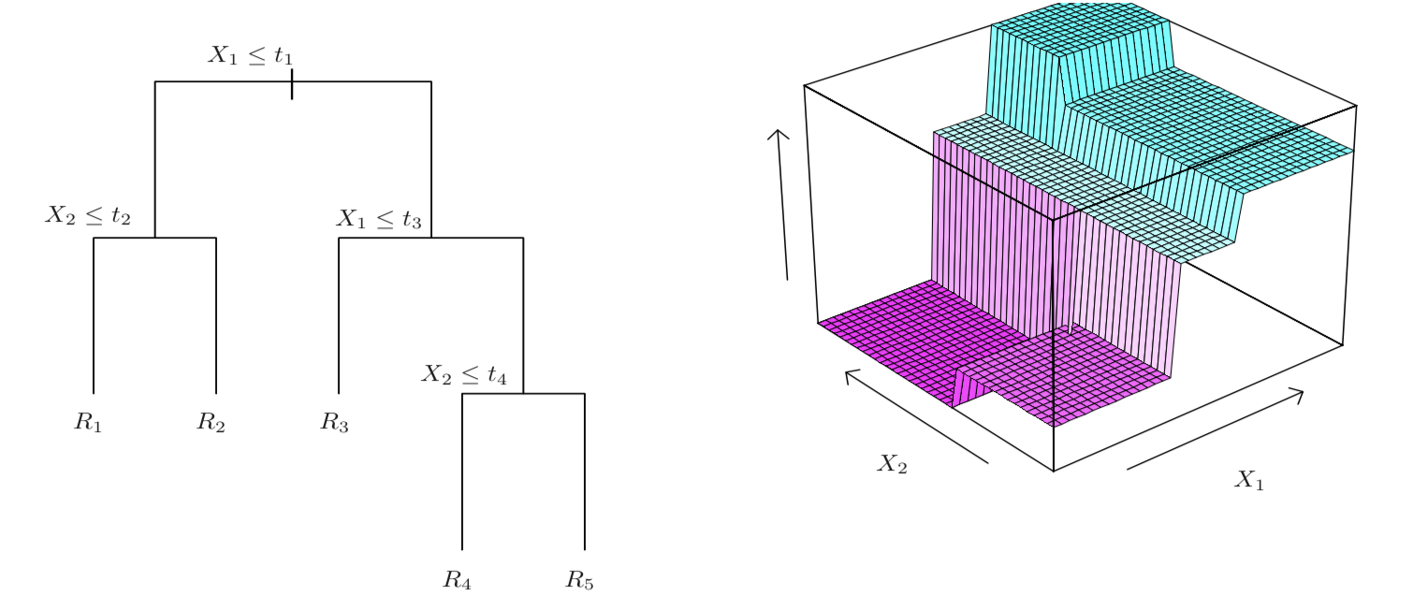
Growing a Decision Tree
Recursive binary fitting
Find a predictor Xj and a cutpoint s that gives the best RSS by splitting the predictor space into {X | Xj < s} and {X | Xj >= s}.
Repeat: find the best region to split, and the best way to split it. Stop when a leaf/region has too few observations

Slide 68
Pruning
Find a subtree that minimizes the CV error
“Cost complexity pruning”:
For each α, find the subtree T that minimizes RSS(T)+α|T| where |T| = #of leaves = # of regions
As α increases, branches are cut off sequentially
Find the best α by CV
Repeat: find the best region to split, and the best way to split it

Slide 69
Regression Tree Fitting Algorithm
Grow a large tree by recursive binary splitting
Stop when a leaf/region has too few observations
For each value of α, obtain a subtree by cost complexity pruning
Compute the CV error of the subtree corresponding to each α. Pick and output the best subtree

Slide 70
Classification Tree
Predictor space partitioned into J non-overlapping regions R1, R2, . . . , RJ
If an observation (x1,...,xp) falls into Rj:
y_hat = most common class of observations in Rj
Fitting algorithm is the same, but need a different metric than RSS when doing cost complexity pruning:
Classification error: E = 1 − max_k(p_mk ) (p_mk = proportion of obs in Rm from k)
Gini index, measuring the purity of a region Rm
Cross-entropy (similar to Gini index)

Slide 71
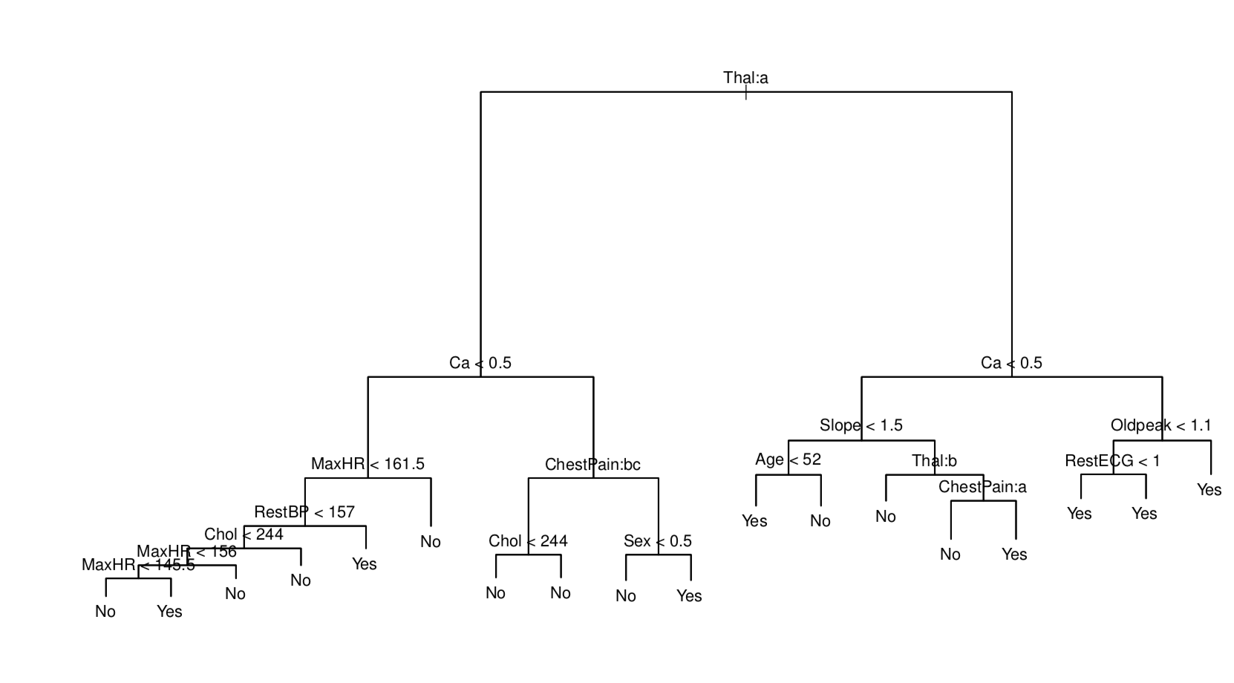
Example: Growing a Classification Tree

Slide 72
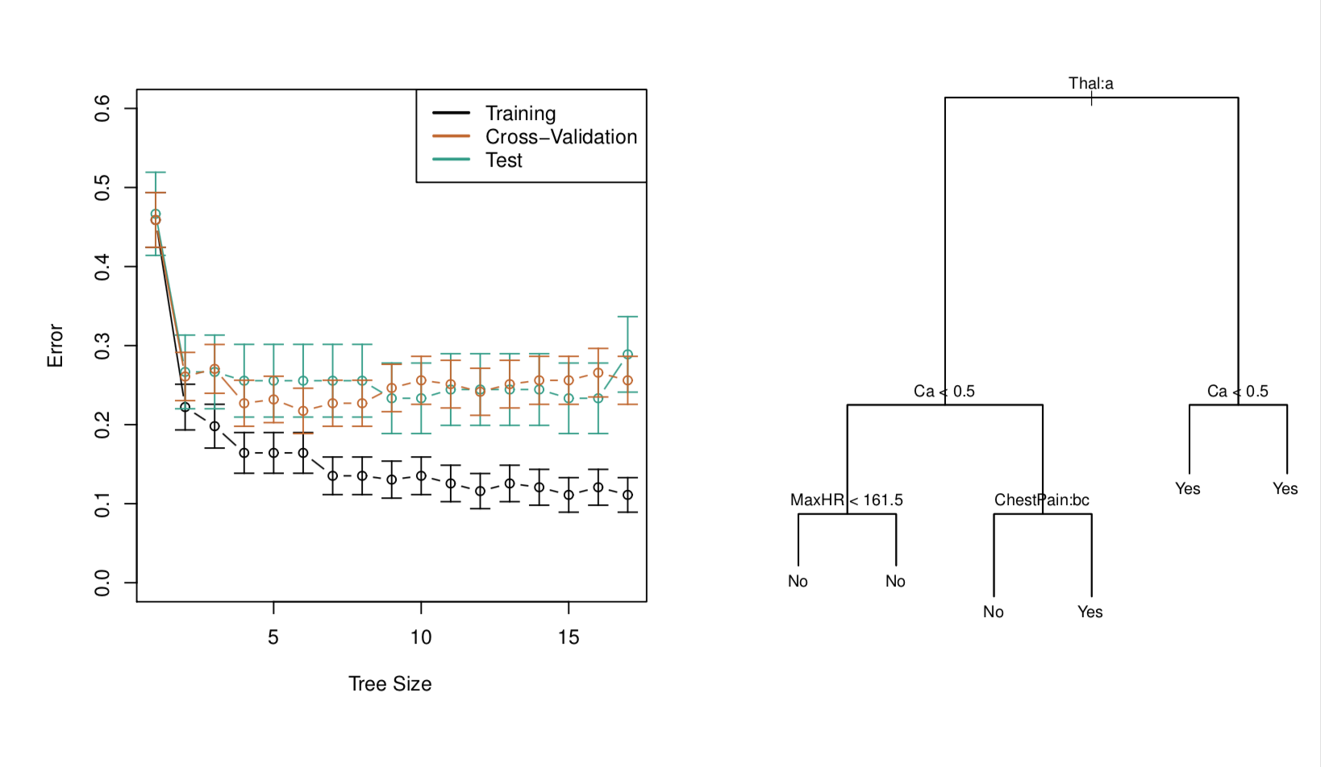
Example: After Pruning

Slide 73
Tree Ensembles
Decision tree is good as it is:
Easy to visualize
Easy to interpret and explain
Easily handles categorical predictors with multiple levels
However, a single tree usually has high variance and is not accurate
Need many trees
Bagging: reduce variance by averaging

Slide 74
Bagging
To reduce variance: average many decision trees
Ideally: Fit trees to many training sets
Alternatively: Divide a training set into B (non-overlapping) subsets
Averaging uncorrelated quantities reduces variance more significantly
But the resulted trees may be very correlated
Random Forest:
decorrelates trees by random feature selection

Slide 75
Random Forest
Growing a tree ˆf ∗b:
Each time a split is to be identified:
Out of p predictors, randomly sample m ≪ p (eg. m = sqrt(p)) of them as candidates
Find the best split based on one of these m predictors
Combine many trees into one model to improve over a single decision tree
Use large trees (grow without pruning) based on bootstrap samples (could change the option of sampling by hyperparameter tuning in sklearn package)
Combine by averaging trees

Slide 76
Demo

Slide 77
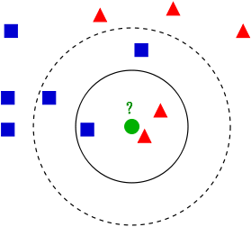
K Nearest Neighbors
For new data points, find the k nearest neighbors with known labels.
Output is majority vote (for classification) or average (for regression) of these neighbors.
Feature selection, value of k, and the distance metric all dramatically affect the output and accuracy.
Very sensitive to noisy/insignificant features.

Slide 78
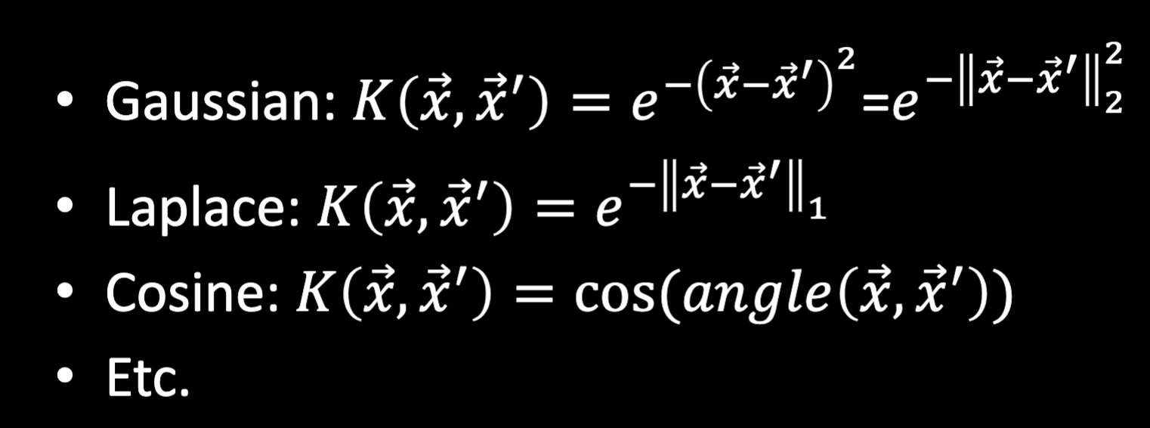
K Nearest Neighbors
How similar are things? Normally think of using Euclidean distance, but just like with loss functions, there’s cases when you’d like to define “similarity” differently.

Slide 79
Demo

Slide 80
Perceptron
Output:
if >0 then classify as 1
if <=0 then classify as 0
Input features
Perceptron
Output = features · weights + bias constant
Simple linear classifier/Hyperplane
Training data are fed in one at a time, weights are adjusted after each incorrectly classified example
Will never converge or classify all training points correctly if the data is not linearly separable

Slide 81
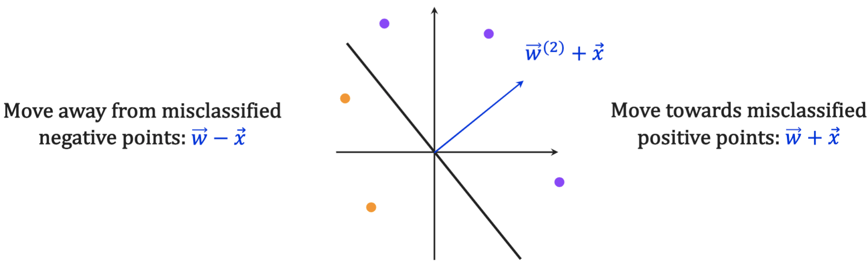
Perceptron
w = (1,1); x = (-1,4) and y = -1 then w = (2,-3)

Slide 82
Demo

Slide 83

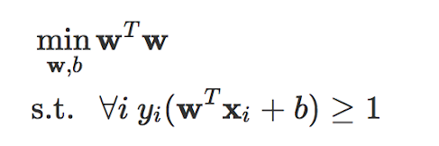
Support Vector Machines (SVM)
“The Social Distancing of Hyperplanes” - Thorsten Joachims
Similar to the perceptron, where it attempts to find a hyperplane that separates the data.
Maximizes the margin of the hyperplane - the distance between the plane and the closest point in each category (support vector).
Can deal with data that is not linearly separable (unlike the perceptron) - soft margin
Notes:
SVMs have so many different variations, they’ve been adapted to do regressions, binary classifications, multi-class classification, and more. Binary Classification is still their bread and butter though.

Slide 84
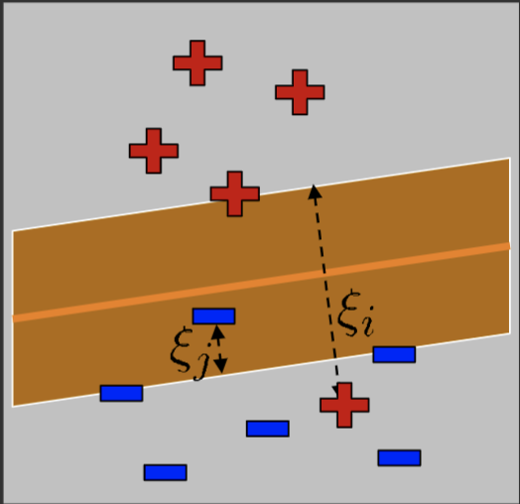
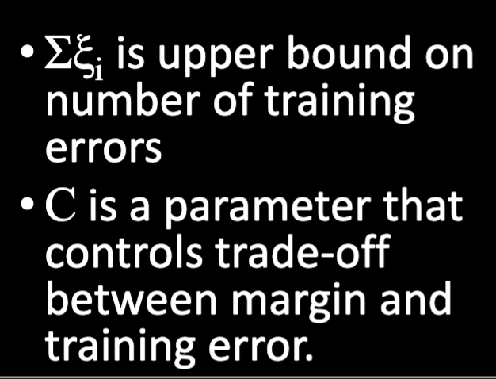
Soft-Margin Support Vector Machines (SVM)

Slide 85
Kernels
(see CS 4780 website: https://www.cs.cornell.edu/courses/cs4780/2019fa/ )

Slide 86
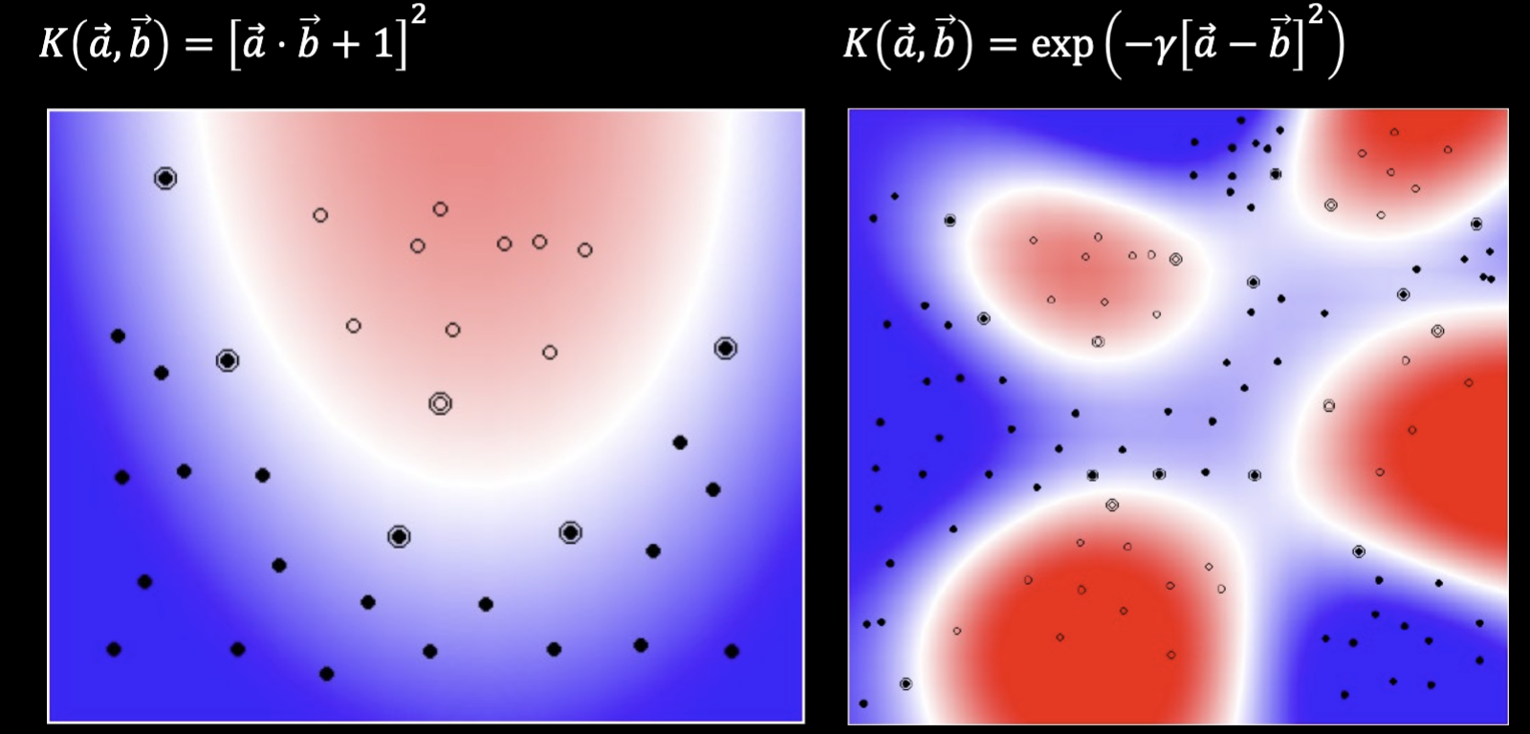
Kernels
Kernels add more features based on its rule. A polynomial of degree 2 would square its features and have those in addition to its original features.

Slide 87
Demo

